Slide 1
Using the DC Abstract Model to Support Application Profile Developers
Sarah Pulis
La Trobe University
sarah.pulis@latrobe.edu.au
Liddy Nevile
La Trobe University/
University of Tsukua
liddy@sunriseresearch.org
Notes:
Develop a data management system; assist in the cultural heritage management of resources; Indigenous Quinkan culture, FNQ
Sophie, experience cataloguer & reference librarian; Expertise: information management.
Not interested in the more technical areas of information systems that are of interest to the computer science community.
Lack of technical knowledge in RDF (mandated) -> language-specific tools out of reach. What happened to 1) Sophie, 2) Me.
Requirement to use UML. In Australia, UML is used extensively to represent .

Slide 2
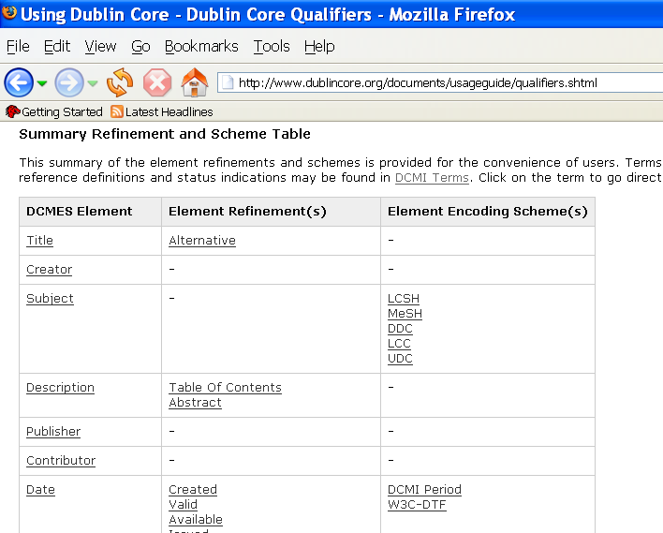

Slide 3
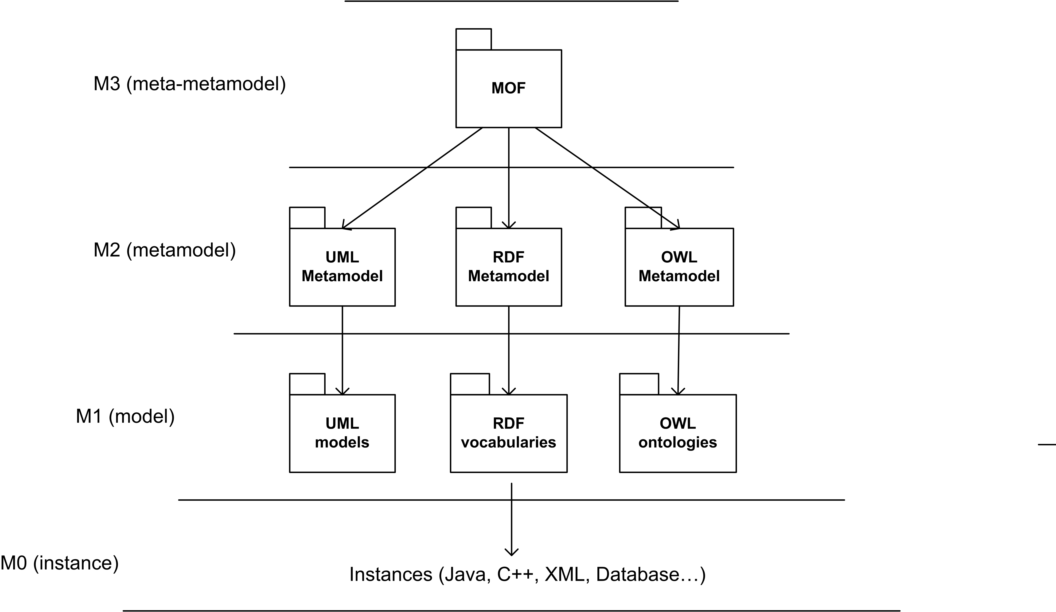
Four Layer Hierarchy
Ontology
Definition
Metamodel
DCMI
Metamodel
Ontologies
App. Profiles based on DCAM
Notes:
UML is a language that can be encoded in an number of different languages.
M3 - meta-metamodel used for defining languages – Meta Object Facility
M2 – Language Definitions – Ontology Definition Metamodel abbreviated ODM
M1 – User defined models.

Slide 4
DCMI Abstract Model (DCAM)
Graphically represented as a UML class diagram but not designed to be used “as is” in software development
Use the DCAM as a base for the development of the DCMI Metamodel
  Analyse the DCAM
  Develop a “UML-compliant” DCAM
  Develop the DCMI Metamodel
Notes:
In text and graphically.
Represented using UML class diagrams but not in a way that allows the DCAM to be immediately encoded as would be the case if it was conformant UML. In other words UML is used to show the model but it is not a UML conformant diagram and it wasn’t intended to be.
Analaysis of the current version of the DCAM, March 2005

Slide 5
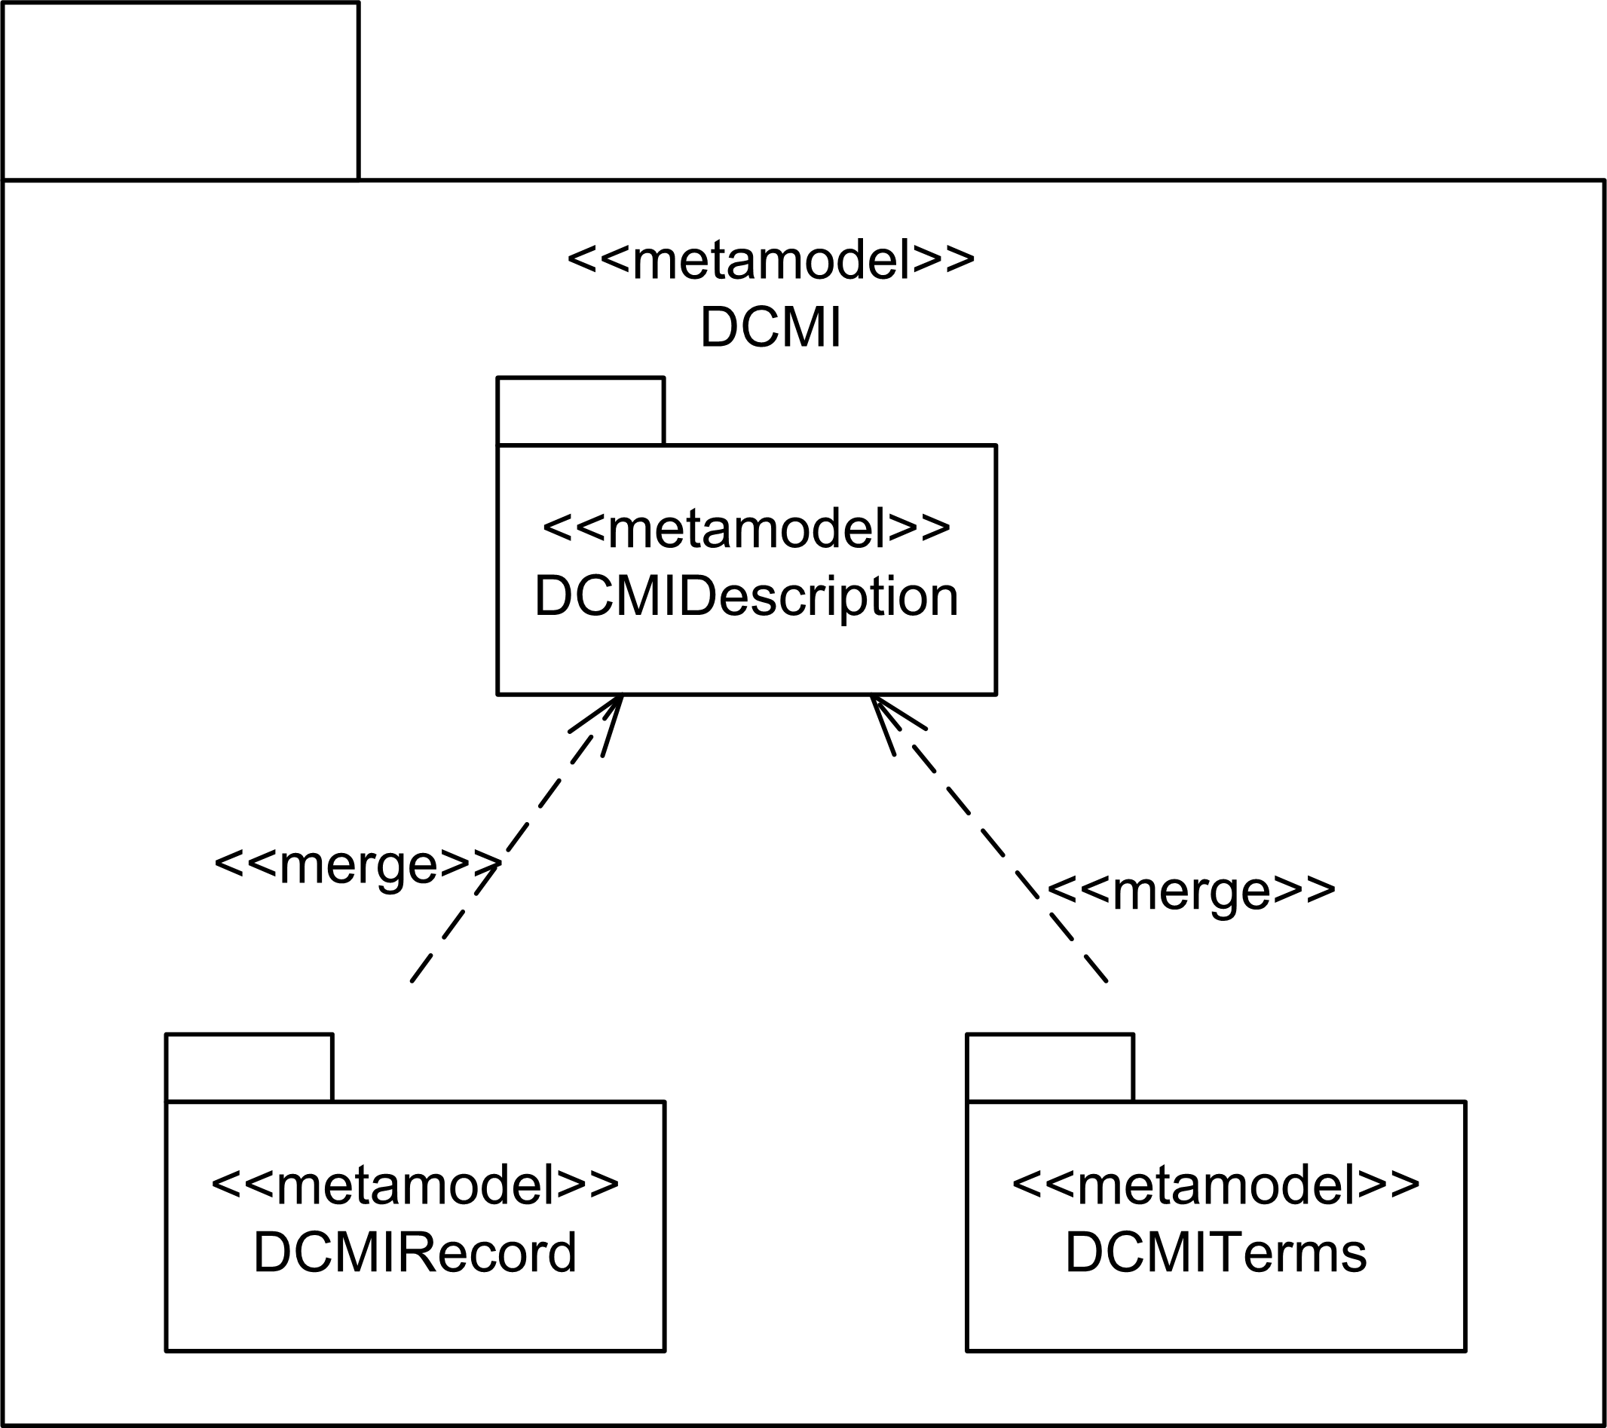
DCMI Metamodel - Overview
Notes:
DCMIDescription package – based on the DCMI Description model of the DCAM
DCMITerms package – based on analsysis of the DCMI Metadata Terms recommendation. Includes elements from the DCMI resource model such as refinement between two elements (or the sub-property relationship). Also includesDCMI recommended attributes for describing DCMI Metadata Terms.
DCMI Record package – enables the use of namespaces and fragment identifies (namespace and name).
Structure of the packages allows the Description model to be used without using the Record or Terms model.
Machine-readable format of the abstract model.

Slide 6
User Models
Ontology
Definition
Metamodel
DCMI
Metamodel
Ontologies
App. Profiles based on DCAM

Slide 7
Supporting application profile developers
Leveraging UML notations and tools
«DCMIProperty»
Date
«DCMISyntaxEncodingScheme»
W3CDTF
«encodingScheme»
«subProperty»
«subProperty»
«DCMIProperty»
Created
«DCMIProperty»
Available
Notes:
Syntax-independent graphical representation of DCMI metadata terms and application profiles based on the DCMI Metamodel
“Visual” human-readable format.

Slide 8
Supporting application profile developers
«DCMIProperty»
Description
«subProperty»
«subProperty»
«subProperty»
«DCMIProperty»
Art Census
«DCMIProperty»
Abstract
«DCMIProperty»
Table of Contents
«subProperty»
«DCMIProperty»
Rockart Technique
«DCMIVocabularyEncodingScheme»
Quinkan Rockart Technique
«encodingScheme»
Notes:
Because the application profile developer needed to extend Description…

Slide 9
Supporting application profile developers
Export syntax-independent models into syntax-specific formats
  Mapping DCMI to RDF
  Mapping DCMI to UML
  XML Metadata Interchange (XMI) for exportation to XML, XHTML
Notes:
XMI -> sharing objects using XML
Yes, you do need a specification but you can use this process to map.

Slide 10
Conclusion
Applicable to the wider community of application profiles developers
Opens communication lines between application profile developers and software developers
The DCMI Metamodel may contribute to the work being done on the DCMI Abstract Model
Notes:
We did this for Sophie, there are other people wrestling with similar problems we thought it might contribute something to the work on the abstract model and help the application profile developpers.

